Slide 1
Json apis

Slide 2
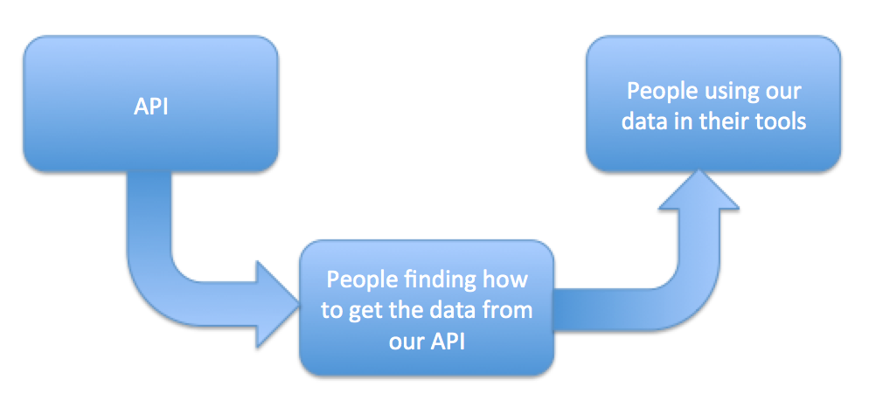
What are apis
Application Programing Interface

Slide 3
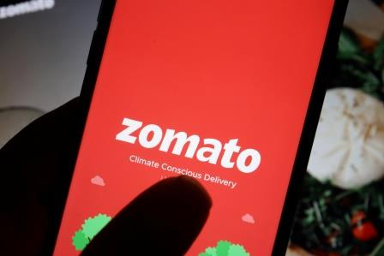


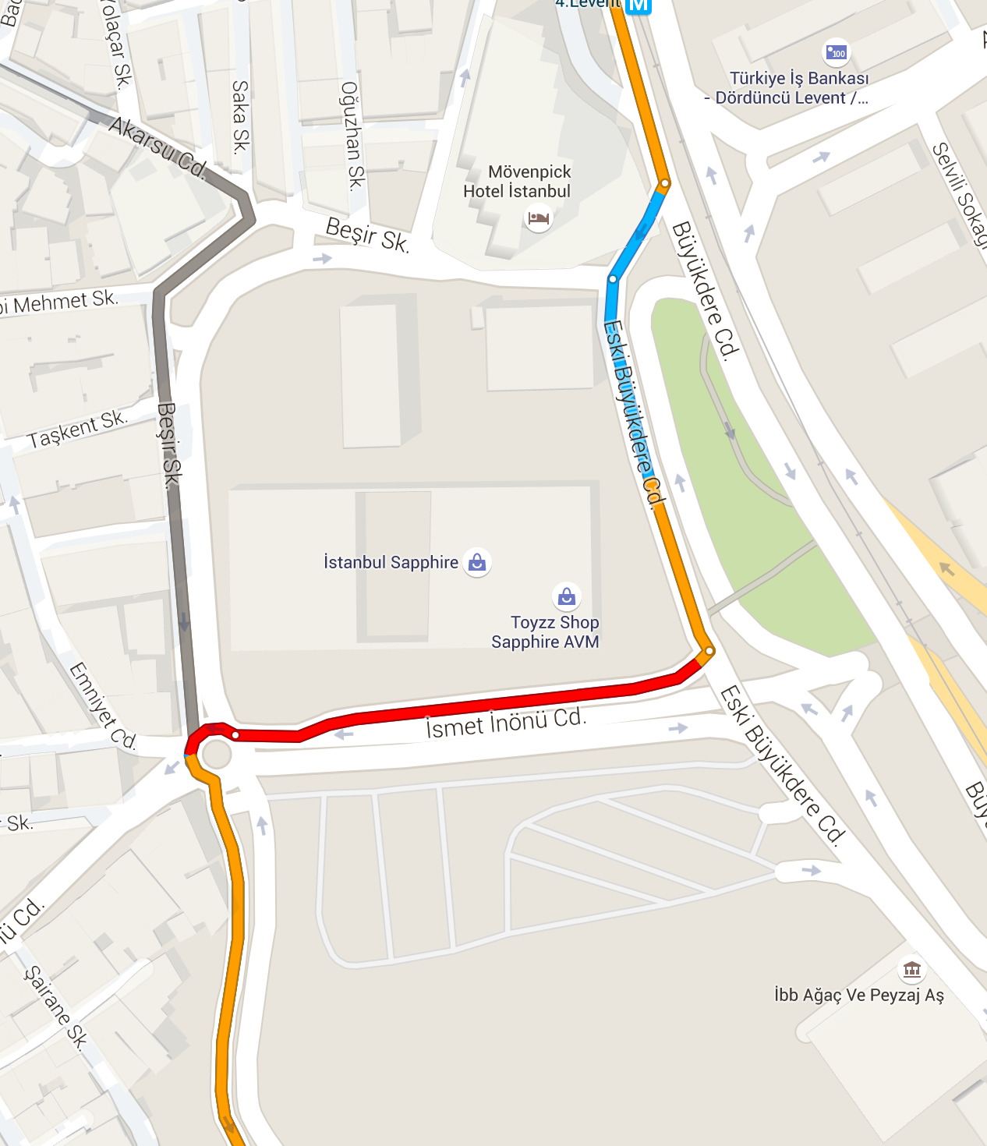
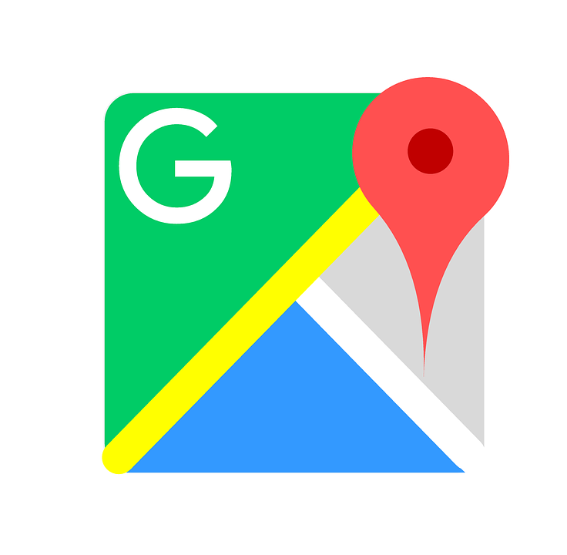
Application Programming interface

Slide 4
Where does zomato brings maps ???

Slide 5
Google Maps System

Slide 6
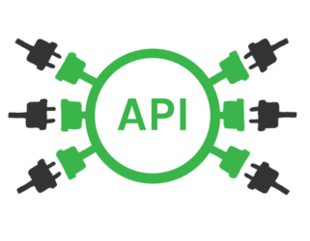
Google Maps System

Slide 7

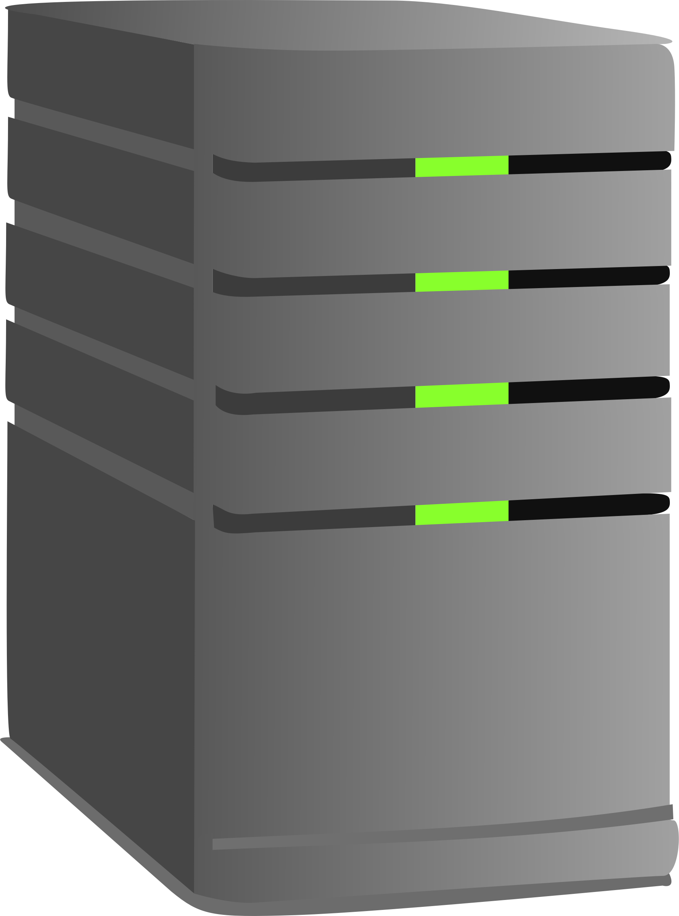
Google Maps System

